Slide 1
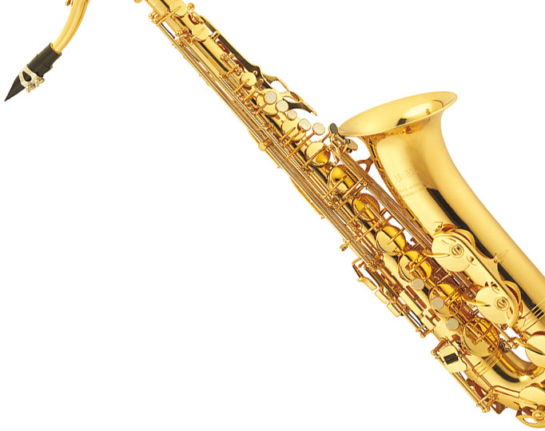
Join the Band
Hurffville Elementary School
Ms. Sebastiani, Band Director
lsebastiani@wtps.org

Slide 2
Dear Parents, The next few slides will contain videos that you should watch with your child. After you have viewed them, please come back to this slide and click on the following links that you’ll need for forms and information about becoming part of the band!
..\Documents\Elem Band Recruitment Letter 20-21.pdf
BAND SIGN UP FORM
BAND AND ORCHESTRA
RENTAL AGREEMENT

